Slide 1
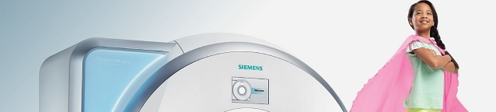
Weill Cornell Imaging at NewYork-Presbyterian in Collaboration with Siemens and Marvel Comics Presents: MRIamaHero! Pediatric Program

Slide 2
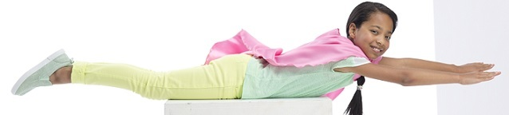
The mission
reduce the number of children undergoing sedation for an MRI
Sedation comes with health risks such as nausea, grogginess and in some cases, problems with breathing and/or developmental delays not to mention anxiety to child/parent, etc.
Reduce anxiety and fear in children
As part of Siemens MRIamaHero! Program, the MRI Heroes Kit is designed to educate and empower children so they can be imaged with less anxiety by helping them better understand magnetic resonance imaging and the imaging process
BUILD CONFIDENCE
The Superhero experience can boost a child's confidence that can last well after the MRI is over

Slide 3
TARGET AGE GROUPS
Ages 4-10
Video Link
Superhero T-Shirt and Shorts
Plush Toy
Cape
Ages 11-15
Video Link
Superhero T-Shirt and Shorts
Plush Toy and Cape when applicable: Nurse/Technologist can check with the parent while child is changing or in MRI suite

Slide 4
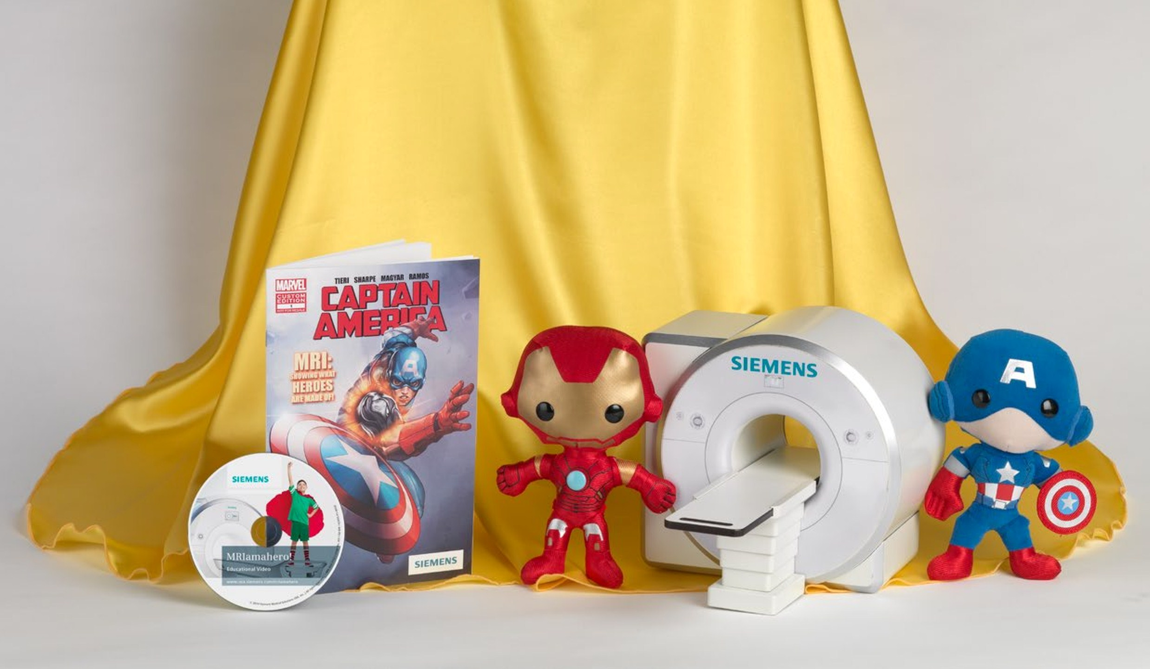
The MRI Heroes Kit Consists of toys and tools to engage the child to help reduce anxiety and improve MRI efficiency by helping them better understand magnetic resonance imaging and the imaging process. Includes
Educational Video
Superheroes Cape and Comforting Items [T-Shirt/Shorts, Captain America/Iron Man/ Spider-Man/ Black Panter/ Wonder Woman Plush Toy]
MRI Mockup Model

Slide 5

Educational Video
The child is able to view the educational video beforehand [email link] or SPC will offer to parent/child upon arrival to be viewed on iPad or Video Book
Takes the child through the process of what happens during an MRI exam
Explains the imaging process in kid-friendly manner through the eyes of a child [contrast/IV, noises to expect, instructions such as breathing/laying still, etc.]

Slide 6
Superhero Costume and Comforting Items
Help pediatric patients feel special and brave
Nurse or Technologist can offer child to dress as a Superhero in T-Shirt and Shorts [instead of a gown] and are presented with a Cape at end of exam (if applicable)
Children can hold onto a Superhero Plush Toy [Captain America, Iron Man, Black Panter, Spider-Man, WonderWoman] during exam and take home with them as a “prize” for completing exam
Plush Toys are available in Clean Supply closets at W84th, York, DHK, Spiral and LIC. Beekman plushes are located at nurses station.
Caped T-Shirts and Shorts are available in Clean Storage with linens

Slide 7

MRI Mock Up Model Only available with sound at York and LIC, available with no sound at W 84th
Kids can see, hear and feel
Child Life uses the mock MRI to help educate children on the imaging process
MRI imaging sounds are generated with the press of a button

Slide 8
STAFF Roles & Responsibilities
REMEMBER: Impressionable age group and the child’s experience with you will shape how they experience these exams through life. For example, one bad experience at the dentist will likely lead to a lifetime of fear of the dentist. Same holds true for Radiology.

Slide 9
POINT OF CONTACT: Scheduling
RESPONSIBILITIES: Customer Service Rep
Identify a patient as 4yrs-15yrs old and needing an MRI
Schedule the patient, first preference should be at WGC, Monday-Friday 8am-5pm (backup sites: w 84th, LIC, Beekman, Spiral and DHK). If parent prefers weekend, refer to pediatric patient policy regarding scheduling details
Explain the program briefly as per below in TABLE 1
Collect the parent’s EMAIL ADDRESS and create problem in Child life review list on Epic so we can send the Video link for the child to watch at home
Add “PEDS” Modifier to the appointment
If pediatric patient is scheduled for an MRI through the MD office, offer pediatric program and obtain parent email if not available, call parent directly

Slide 10
TABLE 1
Items for CSR to mention on the phone with parents:
WCINYP has teamed up with Siemens and Marvel Comics to create a Pediatric Program “MRIamaHero!”
The program aims at reducing anxiety and fear in children and to avoid the use of sedation
The child is able to watch a video at home sent via email, that will explain what their MRI scan will be like. The video is geared towards educating the child as to what they are going to experience. You can expect to receive this video a week before your child’s visit
(If appropriate) We can offer CinemaVision Goggles, child can bring their favorite DVD to the appointment or choose from variety of choices on site
On the day of the exam, the staff will greet the child, and briefly go over what to expect.

Slide 11
POINT OF CONTACT: Contact Prior to Exam RESPONSIBILITIES: Child Life Specialist
Explains to parent that WCINYP teamed with Marvel and Siemens to create a pediatric imaging MRIamaHero! Program. The MRI Heroes Kit is designed to educate and empower children so they can be imaged with less anxiety and without sedation. Includes toys and tools to engage pediatric patients and help them better understand the imaging process
Offers viewing the educational video beforehand [email link] or it can be viewed upon arrival on iPad/Video Book
Explains to parent the full duration of scan, if child is scheduled for more than one exam confirm with parent that child can endure multiple exams at one time
Explains the child will be offered a Superhero Costume (Caped T-Shirt/Shorts) and Plush Toy
Offers Cinemavision, if appropriate (see TABLE 3) and mentions child can bring DVD of their choice or choose from a few that we have [Excludes cardiac/abdomen/pelvis exams due to breath hold requirements]

Slide 12
POINT OF CONTACT: Arrival RESPONSIBILITIES: Senior Patient Coordinator
Knows location of all program materials [See Table 2]
Confirms appt flagged as “Peds Program”
Offers Video on iPad and explains overview of content [7 year old girl’s experience with her first MRI exam..etc.] emphasizing that it’s a great way for the child to better understand what to expect in a fun way
Paperwork to Include Patient
MRI Non-Patient Screening form [Must be completed for all persons accompanying child] Two parents can be in the room for exam if MRI safe

Slide 13
POINT OF CONTACT: Sub-Waiting/Changing Rm RESPONSIBILITIES & EXAMPLE SCRIPT: Nurse
Knows location of all program materials [See Table 2]
Verbalizes with parent/child participation in program
“How are you feeling today - Do you feel like a Superhero?”
“Did you get to watch the video about getting an MRI?”
Provides child with Superhero T-Shirt & Shorts [Some XL T-Shirts do not come with a cape]
“Are you ready to change into your Superhero Costume?”
Encourages child throughout exam referencing video/plush toy making an adventure out of the exam, referring to scenes from the video [Please remember to use a level of discretion/thought in the process regarding age of the child and what they receive]
Notifies Child Life Specialist if supplies are low

Slide 14
POINT OF CONTACT: MRI Suite RESPONSIBILITIES & EXAMPLE SCRIPT: Technologist
Knows location of all program materials [See Table 2]
Offers Cinemavision and understands limitations [See Table 3]
BEFORE EXAM: Offers Plush Toy [Captain America, Ironman, Spider-Man, Black Panther, Wonder Woman] and explains noise, what to expect, how much time it will take, need to lay still, etc.
“Wow, you look like a Superhero!”
“Who is your favorite Superhero?” [Provides plush toy based on response]
“Do want them to come with you when we take your pictures?”
DURING EXAM: Communicates to child throughout exam, time remaining, etc.
“Be sure to lay still just like a statue!”
END OF EXAM: Provides Cape by attaching to child’s Superhero T-Shirt
“Congrats you are a Superhero!”
“Great job, I knew you could do it! “

Slide 15
POINT OF CONTACT: Checkout RESPONSIBILITIES: SPC
Asks the parent/child about his/her Superhero experience
Asks parent/child if they have any questions
Communicates with PM if any additional feedback [positive or negative]

Slide 16
TABLE 2
MRI Heroes Kit Material Locations per Site
W84th: iPad, Video Book at Front Desk Superhero Costume & Plush toys [Caped T-Shirts and Shorts] in Supply Closet to left of elevator | WGC: iPad, Video Book at Front Desk Superhero Costume [ Caped T-Shirts and Shorts] and plush toys in Clean Supply Room: Y3.28, code 1-3-0-5
Beekman: Video Book at Front Desk Superhero Costume [Caped T-Shirts and Shorts] in Clean Supply room & Plush Toys at Nurses Station | Reminders: *Please notify Child Life Specialist is inventory supplies are low *Recharge iPad/ Video Book every night *Discard any used clothing items left behind

Slide 17
TABLE 3
Cinema Vision Chart
 | W84th | WGC | Beekman
MRI | 3T | 1.5 T & 3T340 | 3C034
Limitations | *Cannot be used for: Abdominal, Enterography & Cardiac scans due to breath holds. Up to technologist discretion for Orbits scan | *Cannot be used for: Abdominal, Enterography & Cardiac scans due to breath holds. Up to technologist discretion for Orbits scan | *Cannot be used for: Abdominal, Enterography & Cardiac scans due to breath holds. Up to technologist discretion for Orbits scan
DVD | DVD’s available at location, but patient can also bring their own [Regular DVD ONLY; BLURAY will NOT work] | DVD’s available at location, but patient can also bring their own. [Regular DVD ONLY; BLURAY will NOT work] | DVD’s available at location, but patient can also bring their own [Regular OR BLURAY will work]
Notes | Add “Requested Cinemavision” to Notes after booking appt. | Add “Requested Cinemavision” to Notes after booking appt. | Add “Requested Cinemavision” to Notes after booking appt.

Slide 18
POINT OF CONTACT: Marketing RESPONSIBILITIES: RSL
Marketing is currently educating Referring MDs that we have partnered with Siemens and Marvel Comics to launch a pediatric imaging campaign, which aims at reducing the need for sedation by easing anxiety in young patients who need to undergo an MRI scan. Our goal is to make the MRI a calming, relatable experience while empowering young patients to seamlessly complete the scan
Program includes:
MRI Video: Patient and families can watch our short, fun MRI video to become more familiar before the scan
Viewing options:
Emailed video link: Please provide us with an email address when scheduling at 212-746-6000
Conveniently view video on an Ipad or Video Book at our facilities at arrival
Plush Toy: Child is offered a take-home plush toy, which can accompany them into the scan
Superhero Costume: Take-home Superhero t-shirt and shorts are worn during the scan instead of a traditional medical gown; Capes are provided at end of exam
Cinemavision Goggles: Child can watch their favorite DVD while getting scanned

